Slide 1
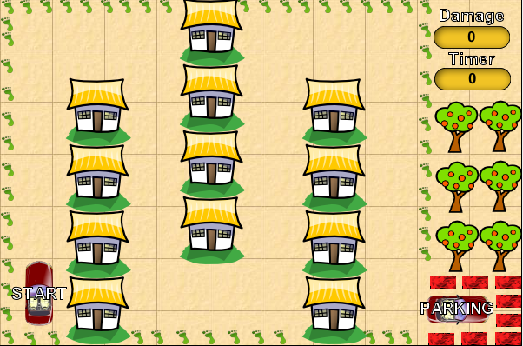
CAR PARKING
JATIN AMBASANA

Slide 2
Outline
Game introduction
Goal of the Game
GitHub Code Link
Key Instructions
Snapshots of the Game
Game Scene
Positive / Negative Scenarios
Game over

Slide 3
Game introduction
Game Topic: “CAR PARKING”
In this Game the player has to
Park the car in proper place
Protect the car from getting damaged
Protect the surroundings from getting damaged
Monitor the damage and timer counters till end
Reach the parting in shortest time

Slide 4
Goal of the Game
The Goal of the Game “CAR PARKING” is to
To move the car from starting point &
Park it to a Parking place
With Minimum damage &
Within Limited time.

Slide 5
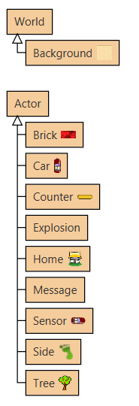
GitHub Code Link
Classes used:
GitHub Link of the Project:
https://github.com/jrambasana/CarParkingGreenfootGame

Slide 6
Keys & Instructions
Up Arrow Key : To move Car Up
Down Arrow Key : To move Car Down
Left Arrow Key : To move Car Left
Right Arrow Key : To move Car Right
‘A’ Key : To Rotate Car Anti-Clockwise
‘S’ Key : To Rotate Car Clockwise
Note:
If Car touches any object then Game plays the warning sound and damage increases.
Maximum Damage = 100 Points
Maximum Time = 100 Seconds

Slide 7
Game Scene

Slide 8
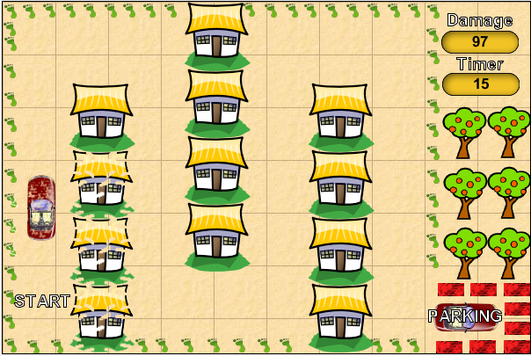
Damage during Game

Slide 9
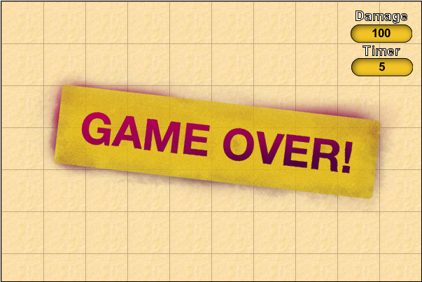
Game Over

Slide 10
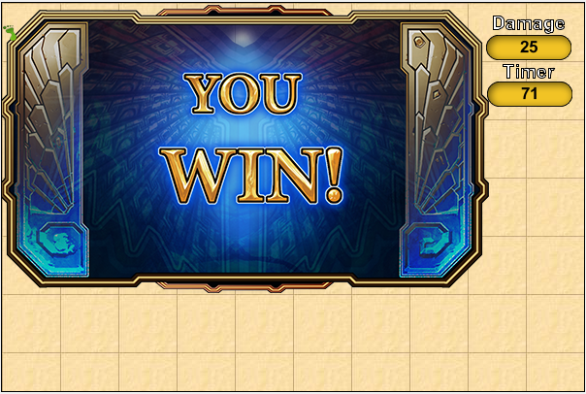
Game Won

Slide 11


